Slide 1








Berserker Story Board
Presented By: 8-Bit Bacon

Slide 2
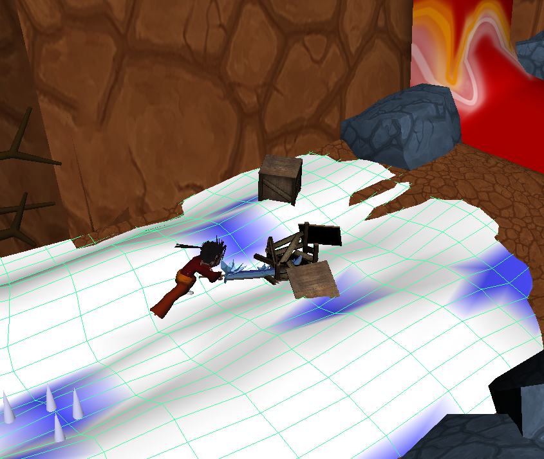
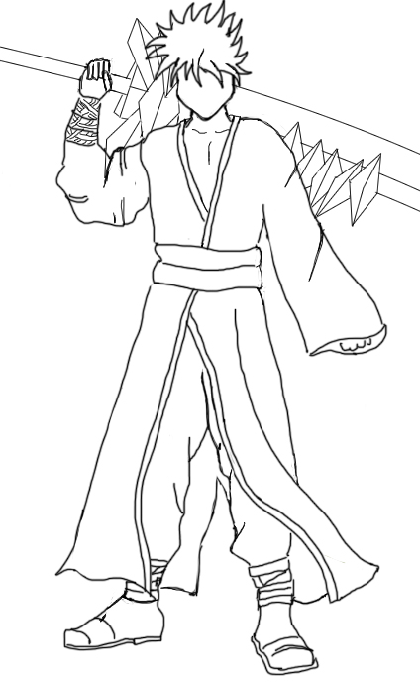
Player
A strong and noble human warrior.
Uses a mystical sword containing the powers of fire and ice.
On a journey to save his lost love.

Slide 3
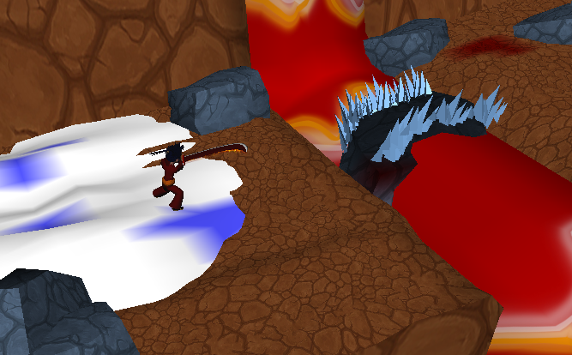
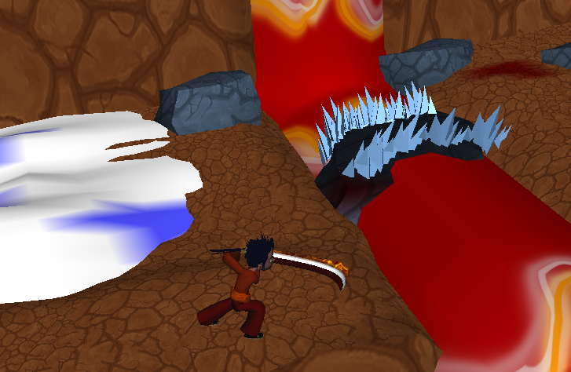
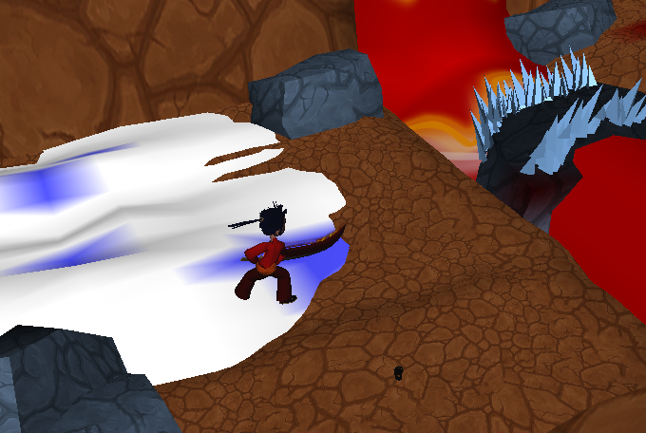
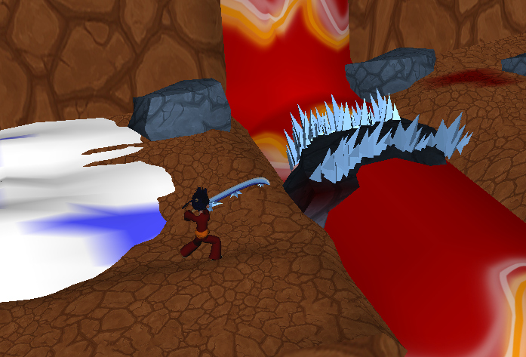
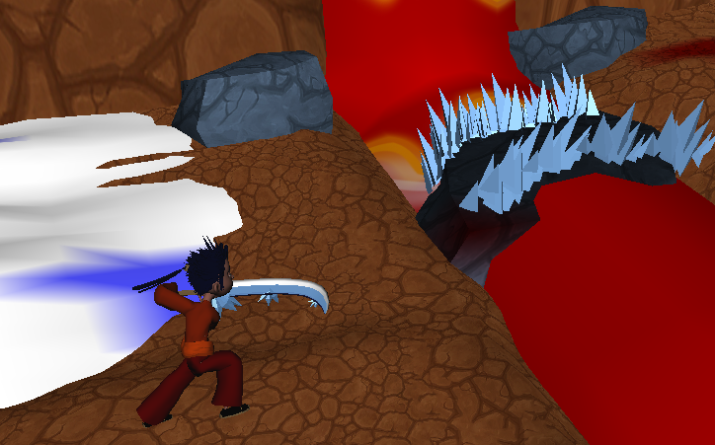
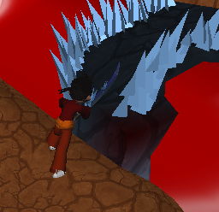
Fire and Ice Attacks

Slide 4
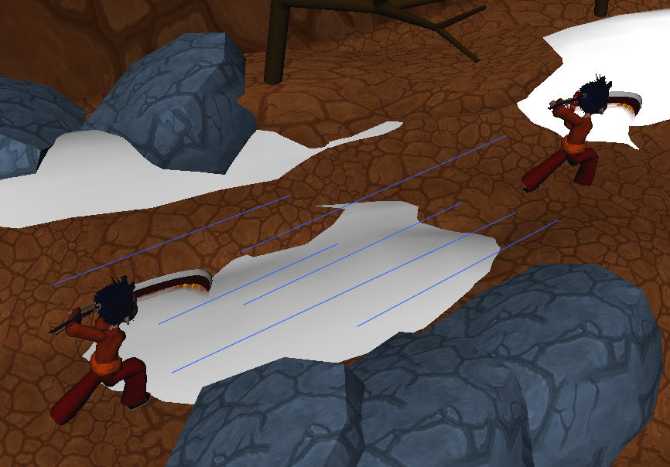
Dash You should use it all the time!
Traverse the level faster
Get closer to enemies
Avoid traps

Slide 5
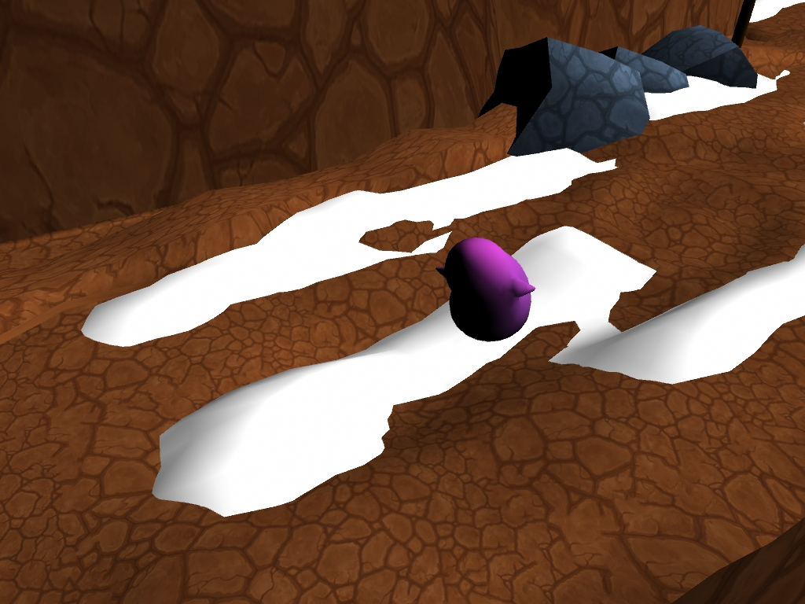
Melee Minion
A small blob creature with little facial features and two arms.
Does weak physical damage to the player.
Dangerous in large groups.
Can be frozen or burned.

Slide 6
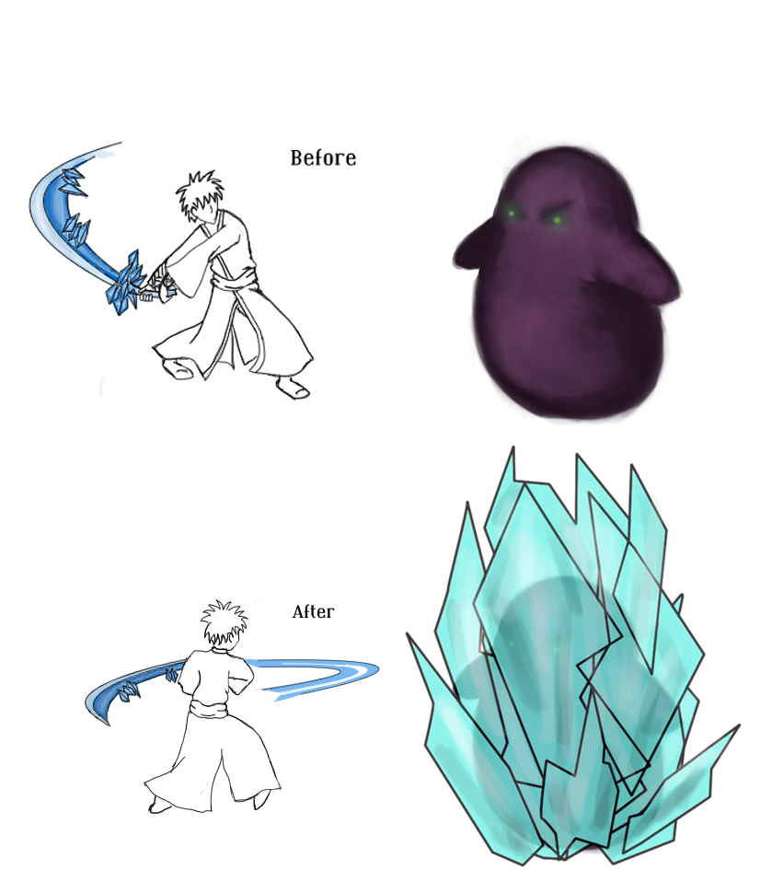
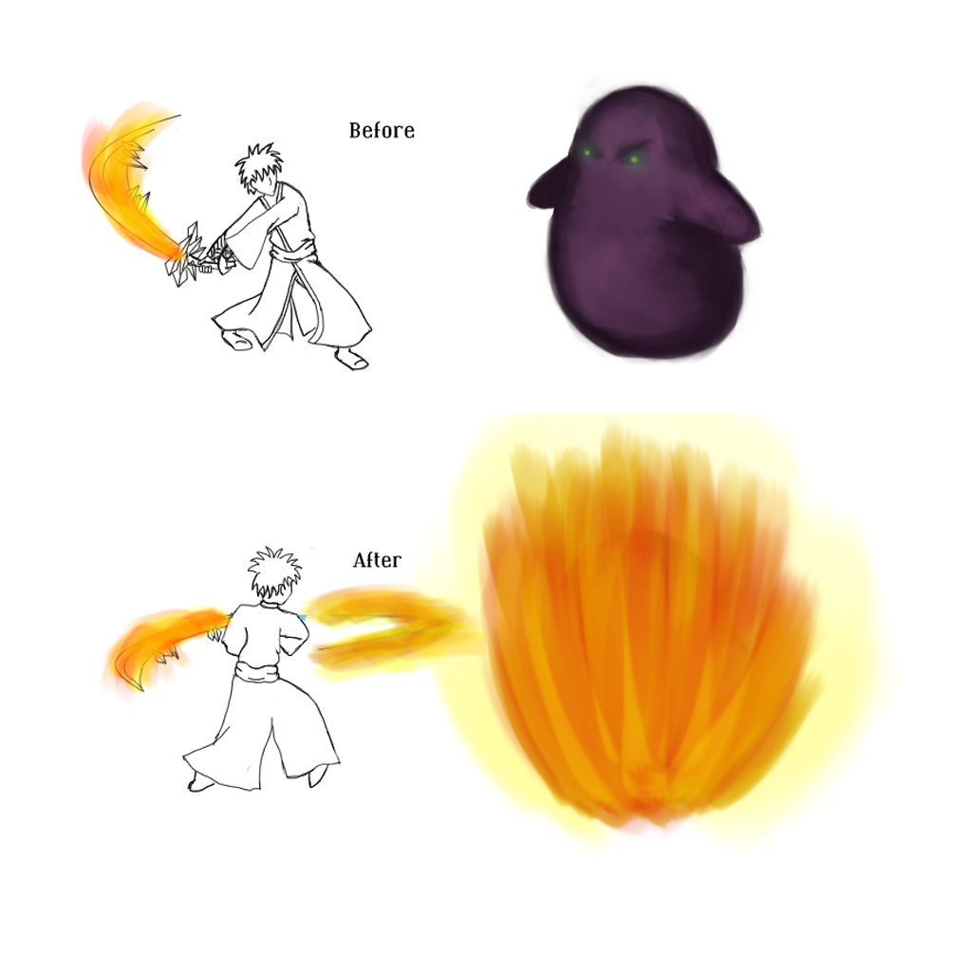
Freezing and Burning (Concept)

Slide 7
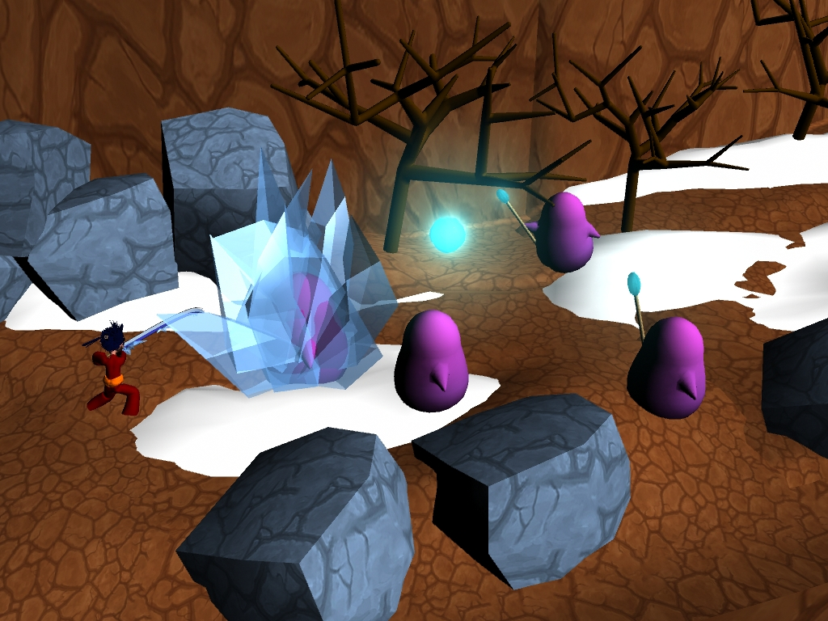
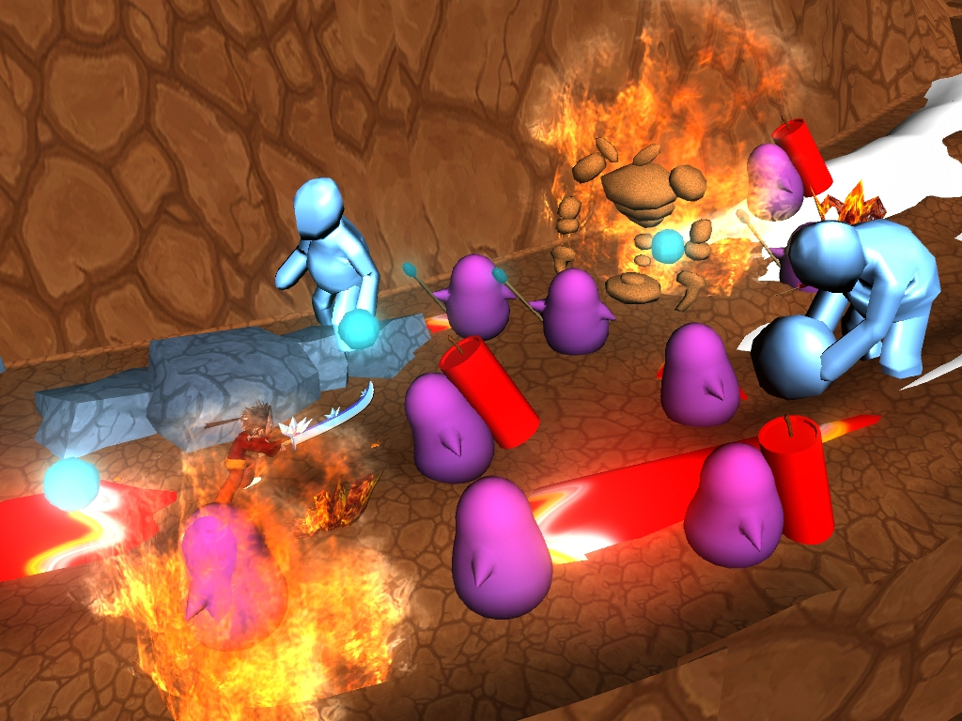
Freezing and Burning (In Game)
Not cool bro!

Slide 8
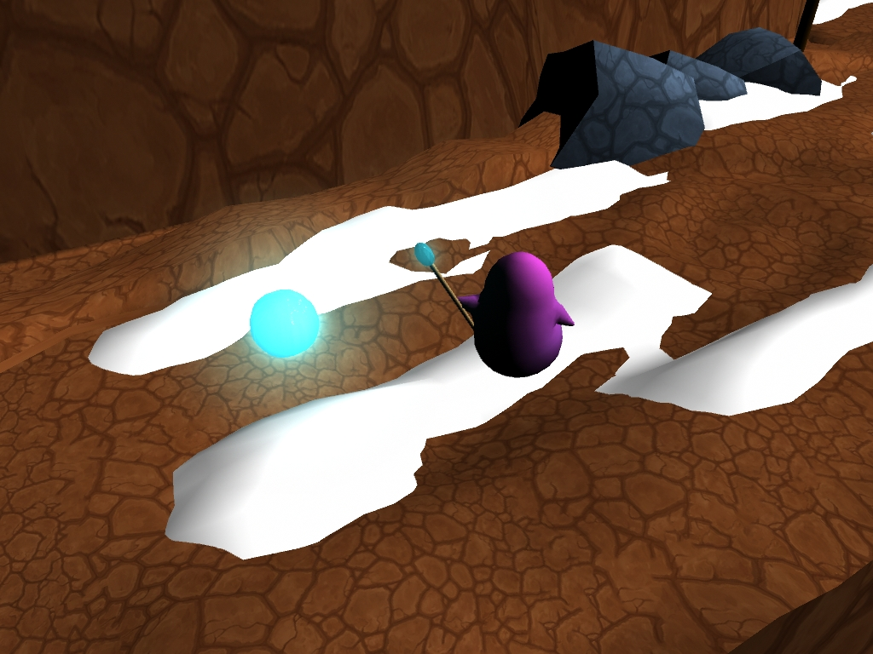
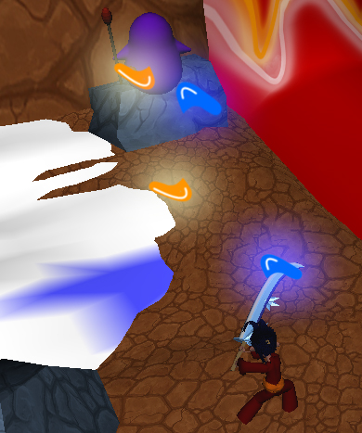
Ranged Minion
Similar to the melee minion except he caries a staff to cast ranged spells.
Casts ranged spells at the player and causes medium damage to the player.
Can be killed with their own attack deflected back at them.
Can be frozen or burned.

Slide 9
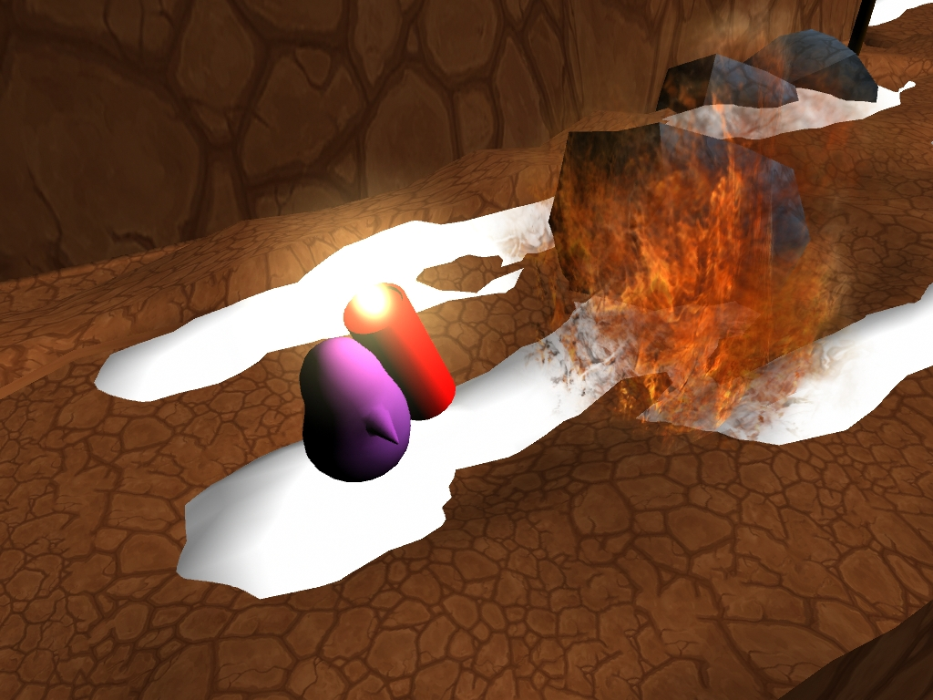
Explosive Minion
Similar to the melee minion except he has a large bomb strapped to his back.
Does massive damage to the player when he explodes.
Dangerous on its own or in groups.
Ice will put out his bomb if lit
Fire will ignite and immediately explode his bomb.

Slide 10
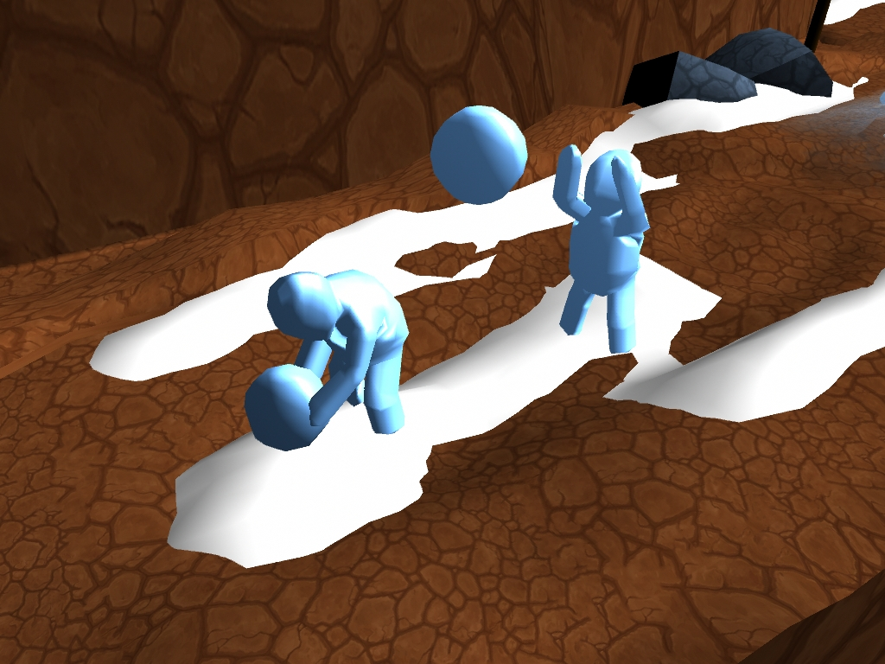
Ice Beast
A big hulking beast made of ice.
Throws snowballs at the player that do massive damage and slow him down.

Slide 11
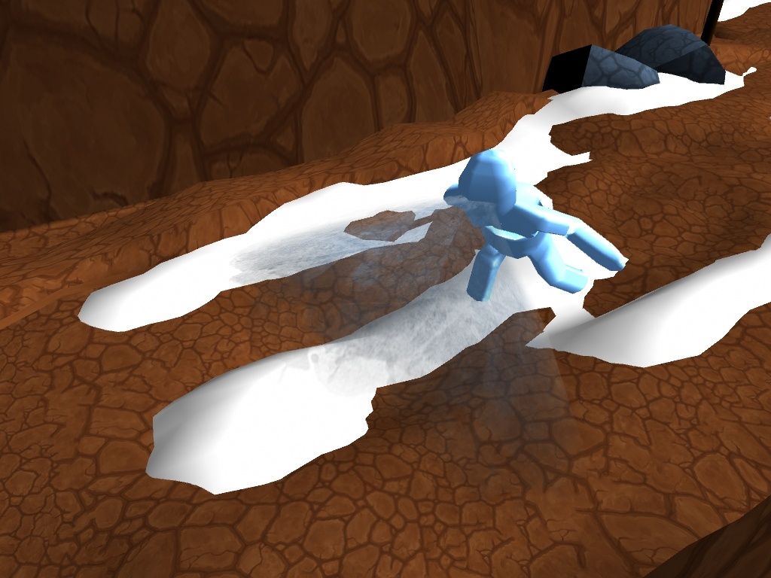
If the player is too close he will use his ice breath that can freeze the player.
Ice will cause it to become stronger.
Fire will be needed to defeat it.

Slide 12
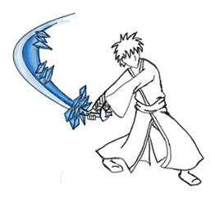
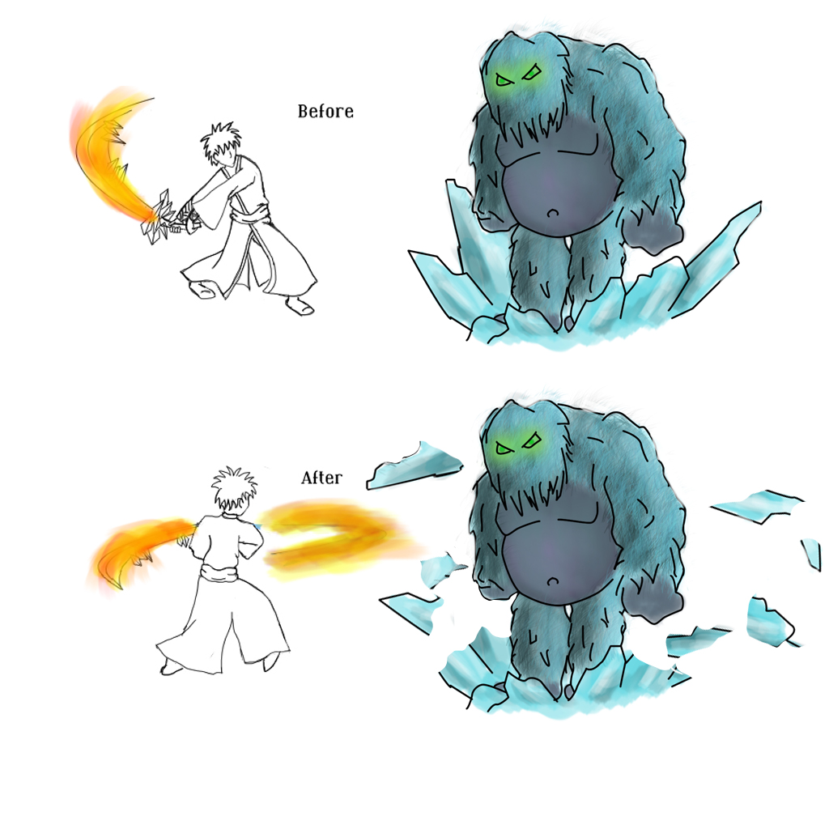
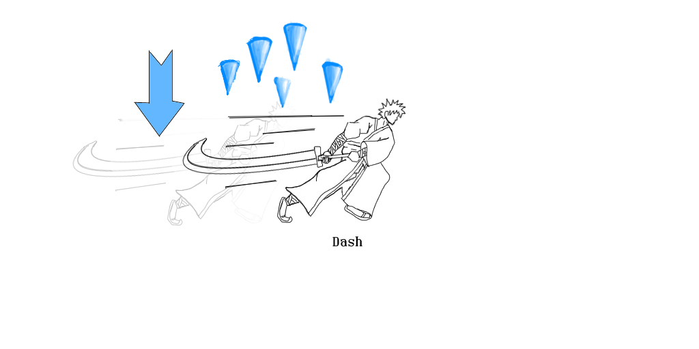
+
Watch Out! Don’t fight Ice with Ice
=
Too bad for you!

Slide 13
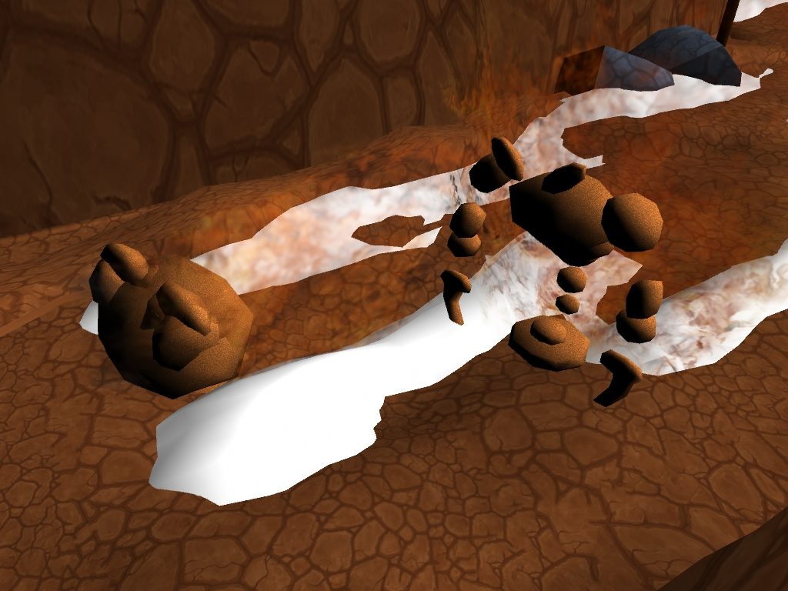
Fire Beast
That’s how I roll!
A creature composed entirely of fire and rock.
Does massive damage to the player by turning into a ball and charging.
While on fire may cause the player to catch on fire.
Fire will cause it to get stronger.
Ice will be needed to defeat it.

Slide 14
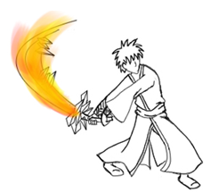
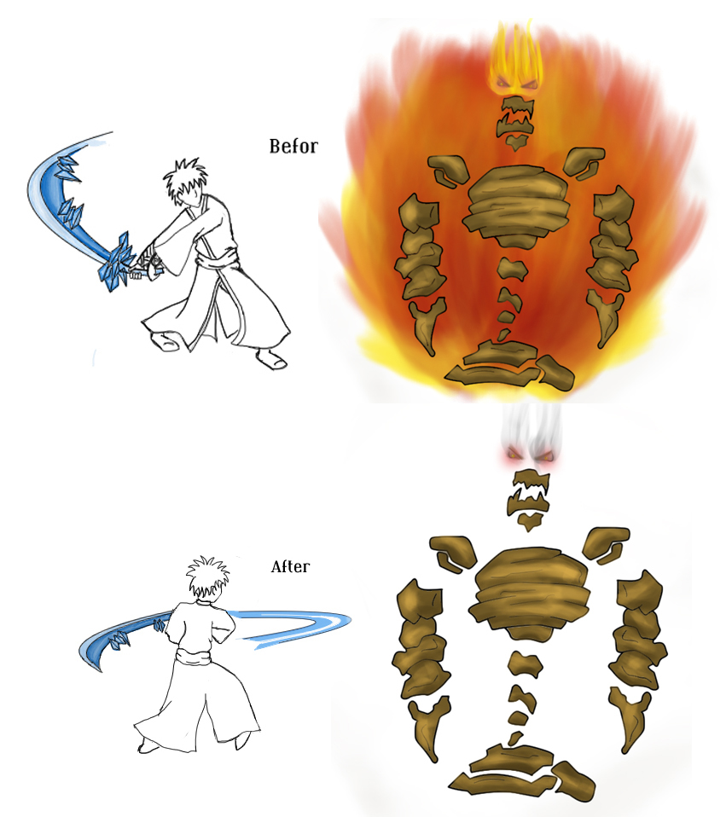
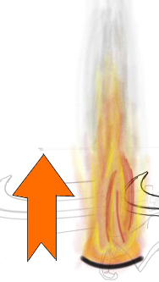
Watch Out! Don’t fight Fire with Fire
+
=

Slide 15
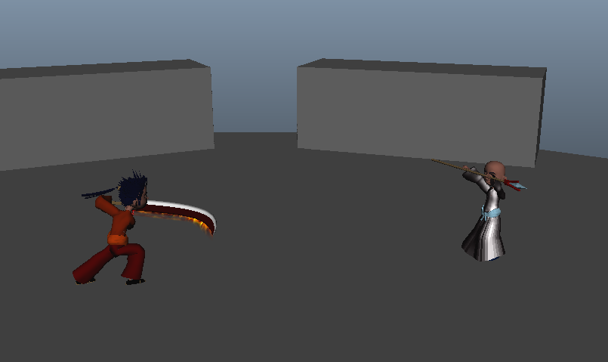
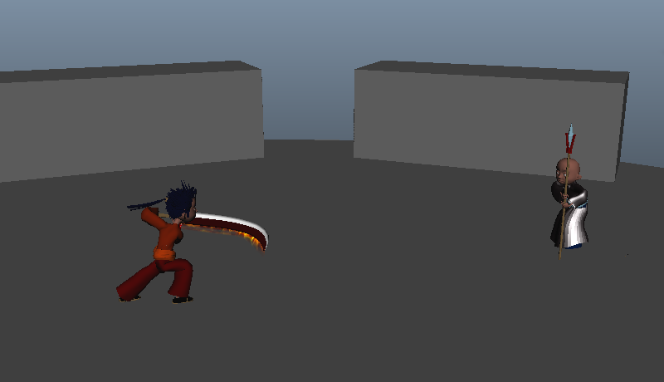
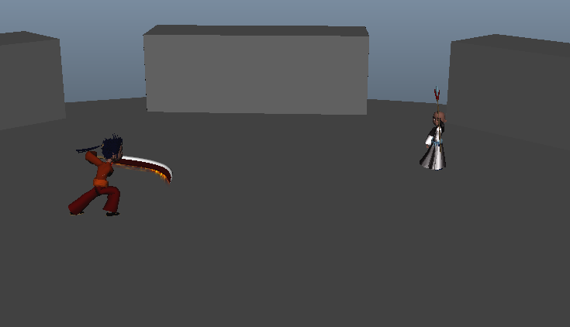
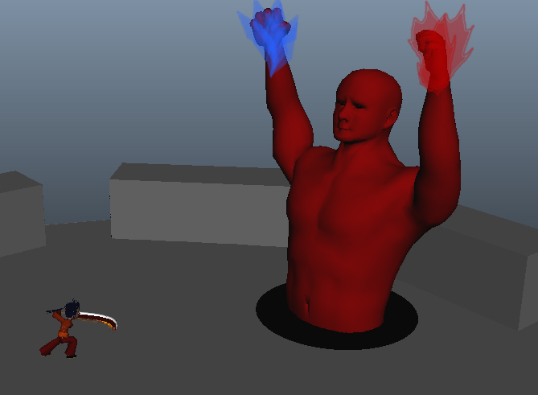
The Wizard
A human wizard adept in the arts of both fire and ice.
Has multiple stages in which the player must overcome.
Both fire and ice will be needed to defeat him.

Slide 16
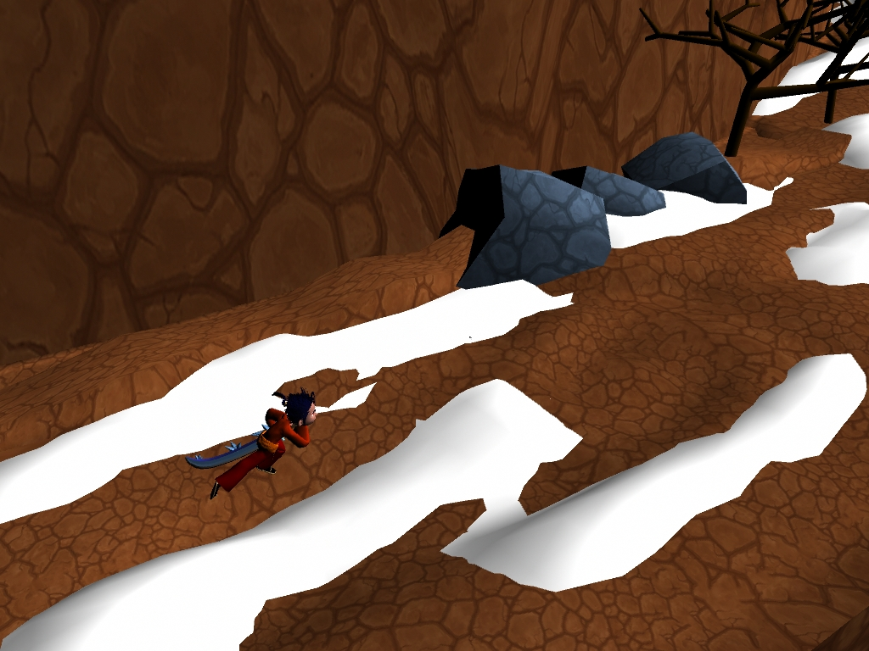
Introduction
Adventure Music
Character at base of the mountain
Wind points the direction to proceed
Player receives control
Notes:
Music begins to play as game starts up.
The camera fades in to the main character standing at the base of the mountain.
The sound of wind is heard followed by the wind blowing in the direction the player needs to go.
The player is given control at this point.

Slide 17
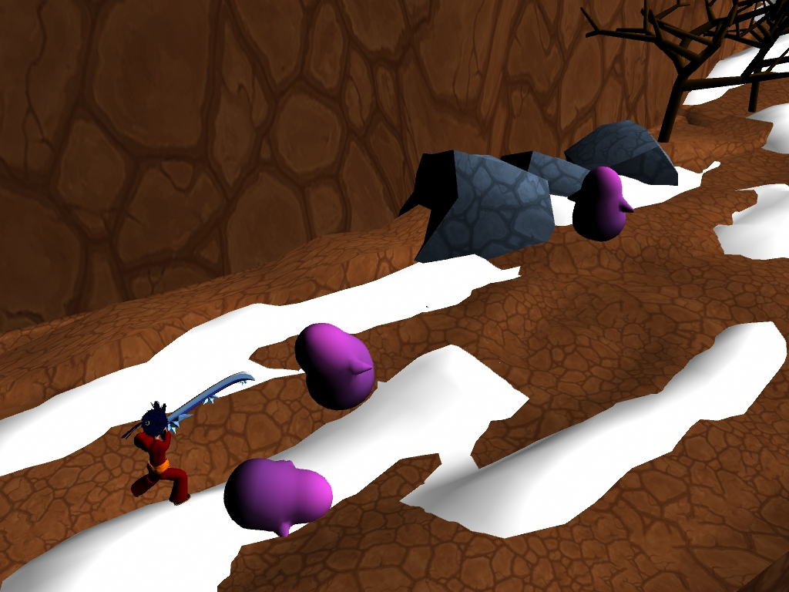
Learn to Attack
W
Sign in the background showing control to Attack
3 Melee Minions
Thump sound
Defeat all to advance
Wind advices player to advance
A
S
D
Movement
J
K
Fire
Ice
Notes:
A sign in the background showing the player how to attack.
3 Melee Minions showing how they attack
A thump sound is heard
The player must defeat all enemies in one area to advance.
Wind advises the player to advance.

Slide 18
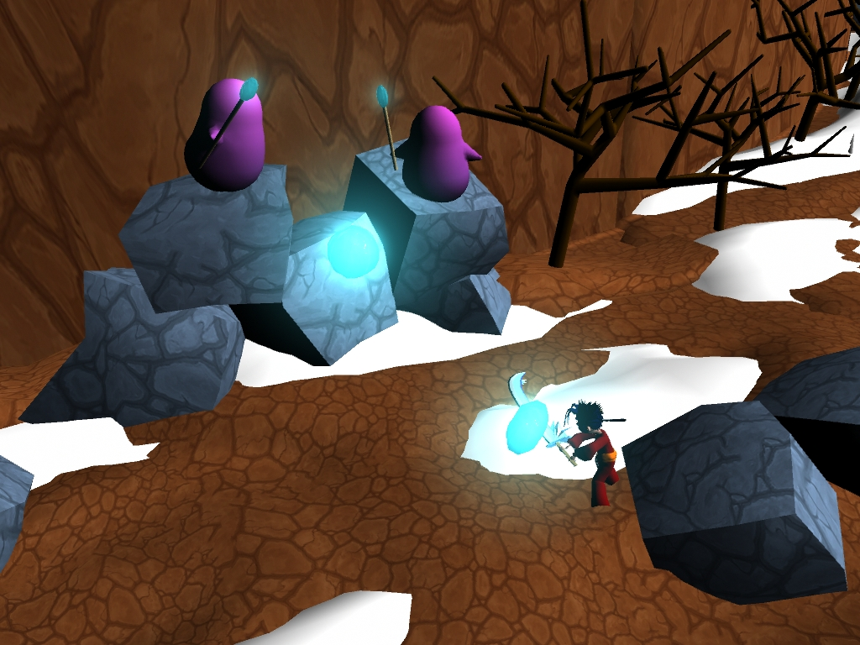
Learn to Deflect
W
Sign in the background showing control to Deflect
2 Ranged Minions in the distance
Spell casting sound
Must deflect
A
S
D
Movement
J
K
Fire
Ice
Notes:
A sign in the background showing the player how to deflect.
Two ranged enemies standing off in the distance attacking
The sound of a spell being cast.
Player must use deflect to defeat them using the correct element based on color.

Slide 19
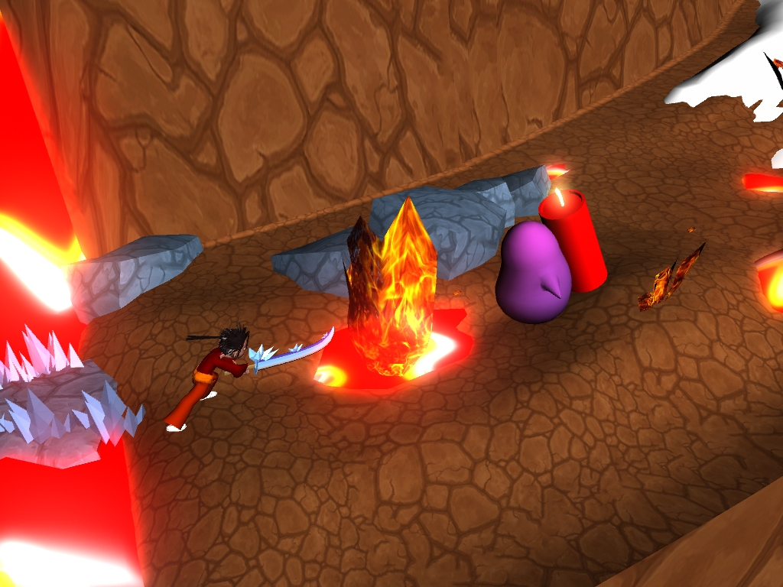
Learn to Dash
W
Sign in the background showing control to Dash
Lava erupting sound
Explosive minion walks into lava, exploding
A
S
D
Movement
Notes:
The sound of lava erupting.
A sign in the background showing the player how to dash.
An explosive minion walks into the lava causing itself to explode.
Player must use dash to advance.

Slide 20
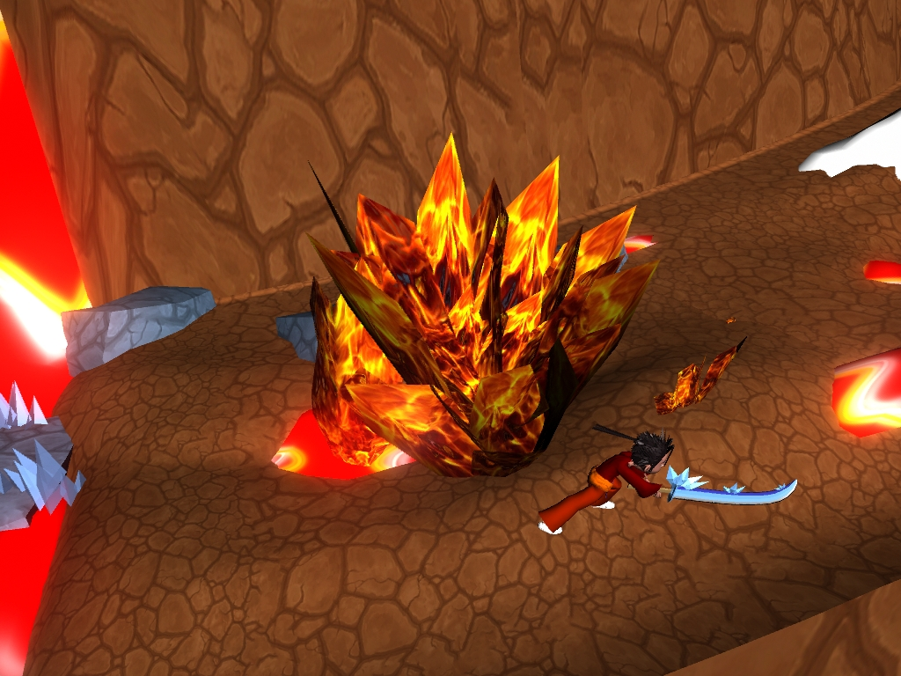
W
Player must dash to advance
In one scene, the player was taught that:
Lava erupting is not cool
Explosive minion + Fire = BOOM!
Dash can avoid explosion/lava
A
S
D
Movement
Spacebar
Dash

Slide 21
First Mixed Fight
W
2 Melee Minions
2 Ranged Minions
A
S
D
Movement
J
K
Fire
Ice
Notes:
A mixed wave of enemies
2 Melee Minions
2 Ranged Minions

Slide 22
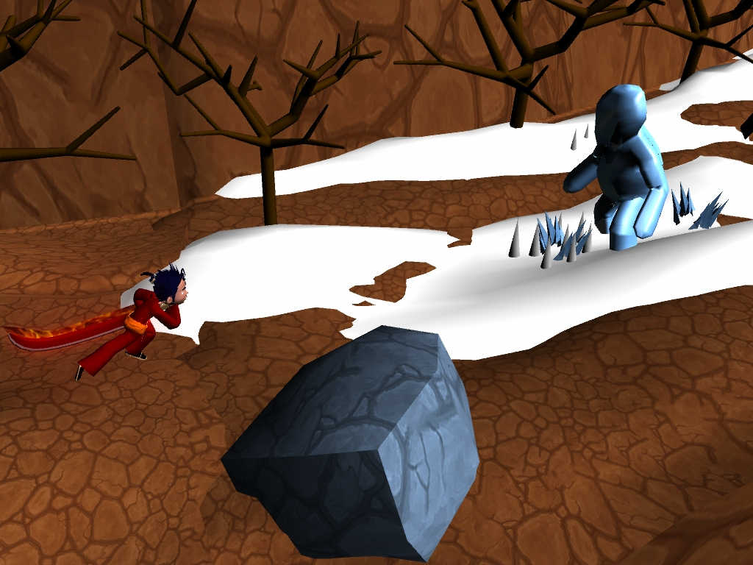
Meet the Ice Beast
W
Ice Beast enters and walks over an ice trap
Ice cracking sound
A
S
D
Movement
Notes:
An Ice Beast enters and walks over an ice trap.
The sound of ice cracking.
Three ice spikes come up buffing the Ice Beast.
The Player must use fire to debuff and kill the Ice Beast.

Slide 23
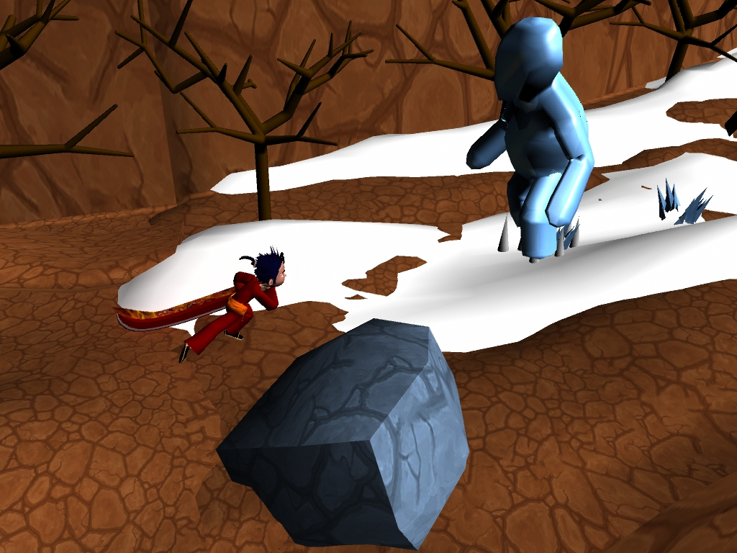
Ice spikes buff the Ice Beast

Slide 24
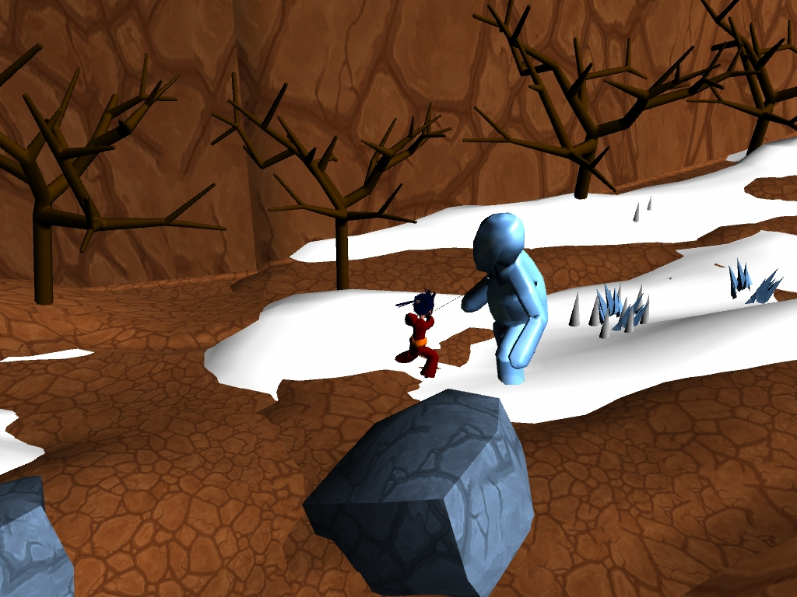
W
Player uses Fire to debuff the Ice Beast,
reducing its size
A
S
D
Movement
J
Fire

Slide 25
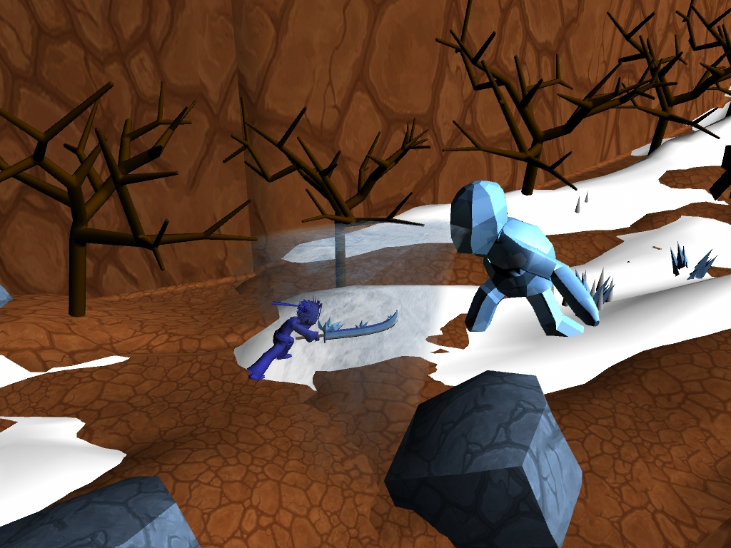
Ice Beast uses freezing breath at Player,
who gets slowed down

Slide 26
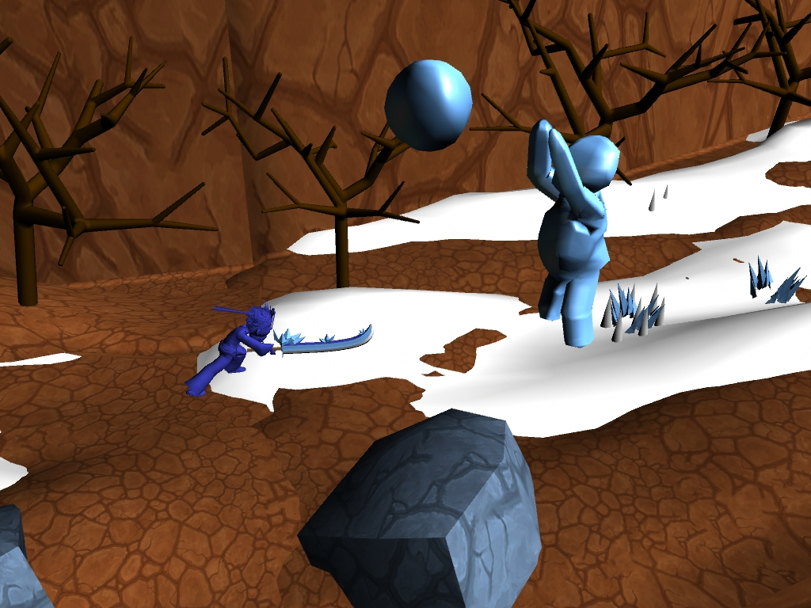
W
Ice Beast throws snowballs at Player,
who needs to dash to escape
A
S
D
Movement
Spacebar
Dash

Slide 27
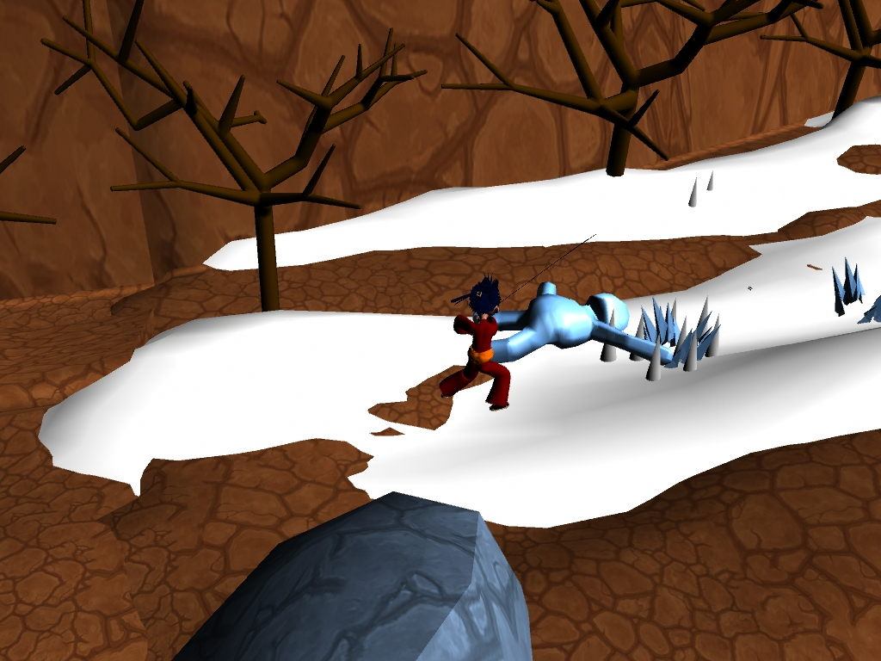
W
By dashing and using Fire, Player can
kill the Ice Beast
A
S
D
Movement
J
Fire

Slide 28
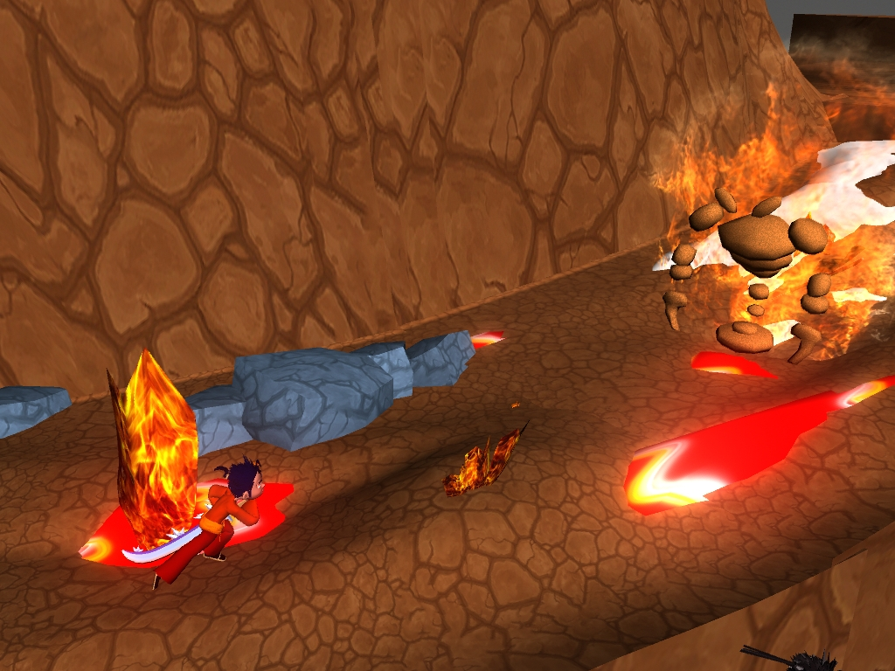
Meet the Fire Beast
W
Fire Beast enters the scene
A
S
D
Movement
Notes:
A Fire Beast enters to attack the player.
The player must use ice to extinguish and kill the Fire Beast.

Slide 29
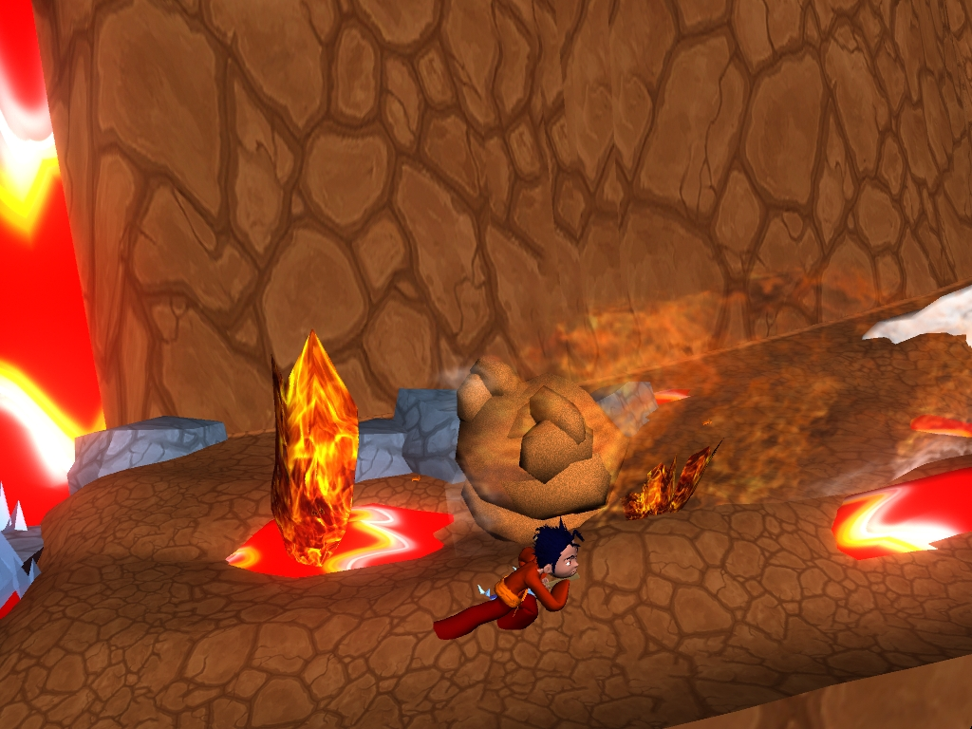
W
Fire Beast rolls at Player, who needs to dash
A
S
D
Movement
Spacebar
Dash

Slide 30
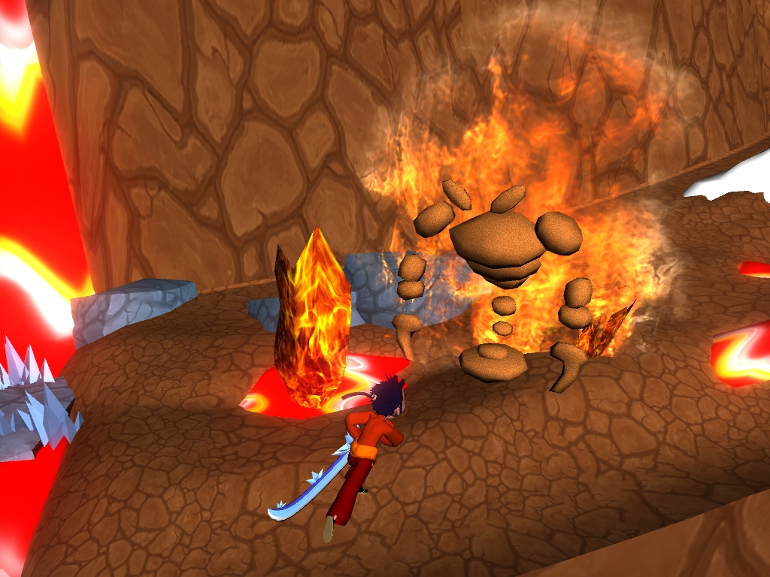
W
Fire Beast comes back to its normal shape
Player goes to attack with Ice
A
S
D
Movement
K
Ice

Slide 31
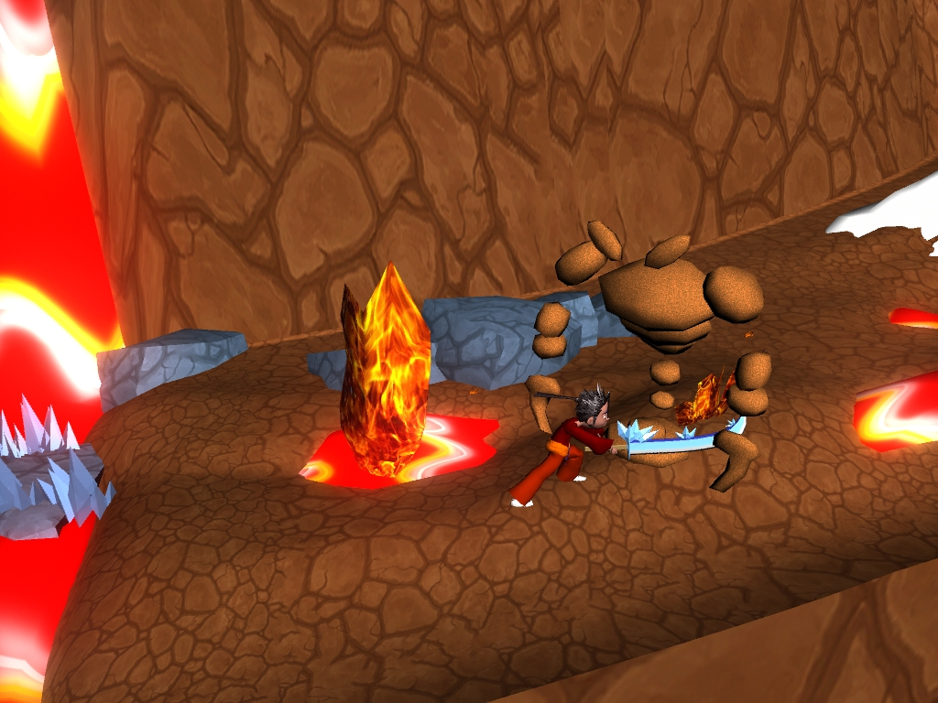
W
Player extinguishes Fire Beast
A
S
D
Movement
K
Ice

Slide 32
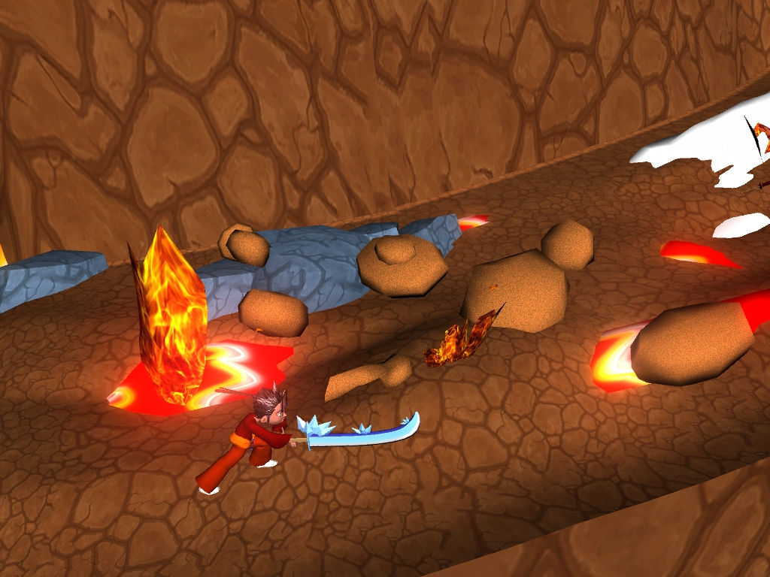
W
By dashing and using Ice, Player can
kill the Fire Beast
A
S
D
Movement
K
Ice

Slide 33
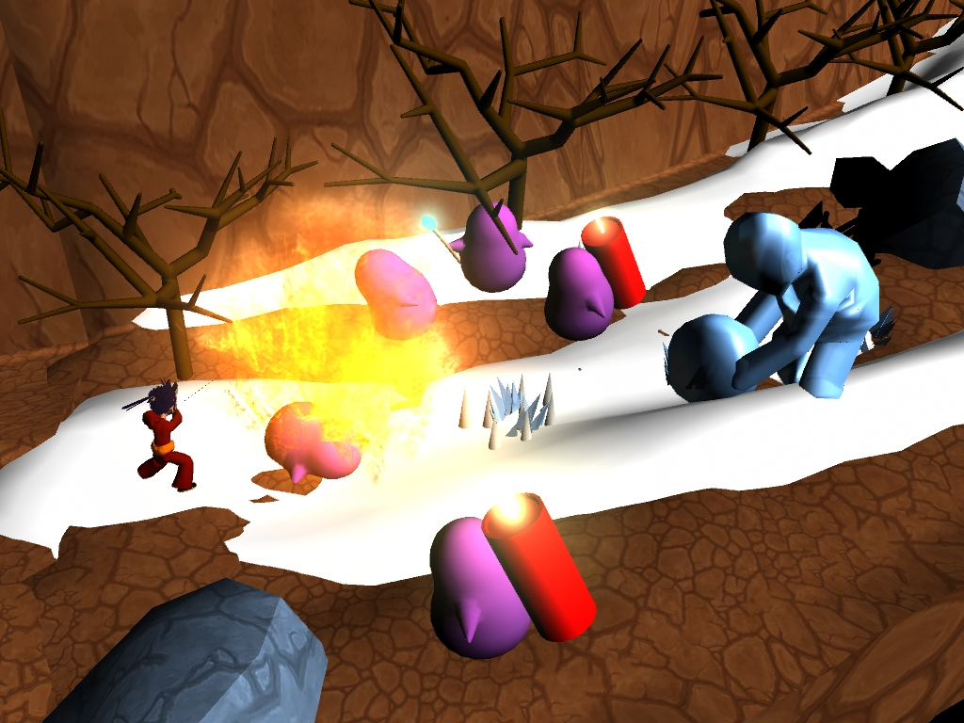
Encounter
W
2 Melee Minions
2 Explosive Minions
1 Ranged Minion
1 Ice Beast
A
S
D
Movement
J
K
Fire
Ice
Notes:
A mixed wave of enemies
2 Melee Minions
2 Explosive Minions
1 Ranged Minion
1 Ice Beast

Slide 34
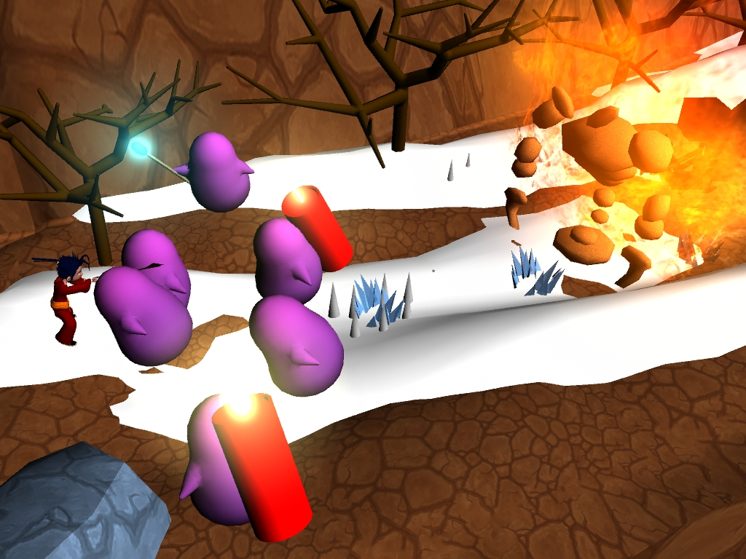
Encounter
W
3 Melee Minions
2 Explosive Minions
1 Ranged Minion
1 Fire Beast
A
S
D
Movement
K
Ice
Notes:
A mixed waves of enemies
3 Melee Minions
2 Explosive Minions
1 Ranged Minion
1 Fire Beast

Slide 35
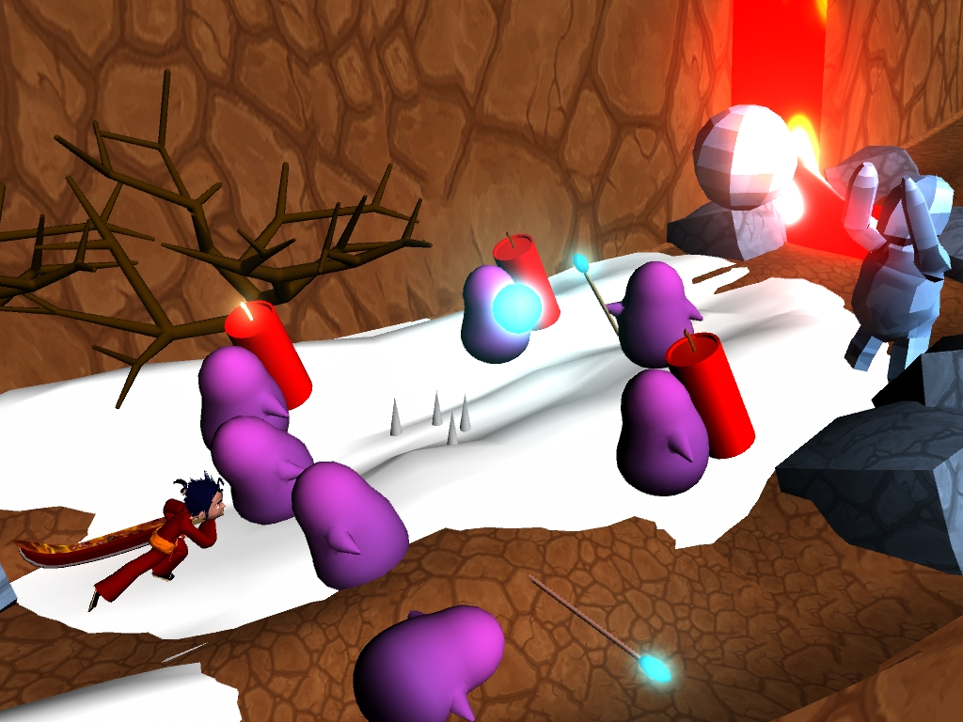
Encounter + Ice Trap
W
Ice Traps – Player must dash
2 Melee Minions
3 Explosive Minions
2 Ranged Minions
1 Ice Beast
A
S
D
Movement
J
K
Fire
Ice
Notes:
Player enters in front of an ice trap.
Player must use dash to get across.
A mixed wave of enemies
2 Melee Minions
3 Explosive Minions
2 Ranged Minions
1 Ice Beast

Slide 36
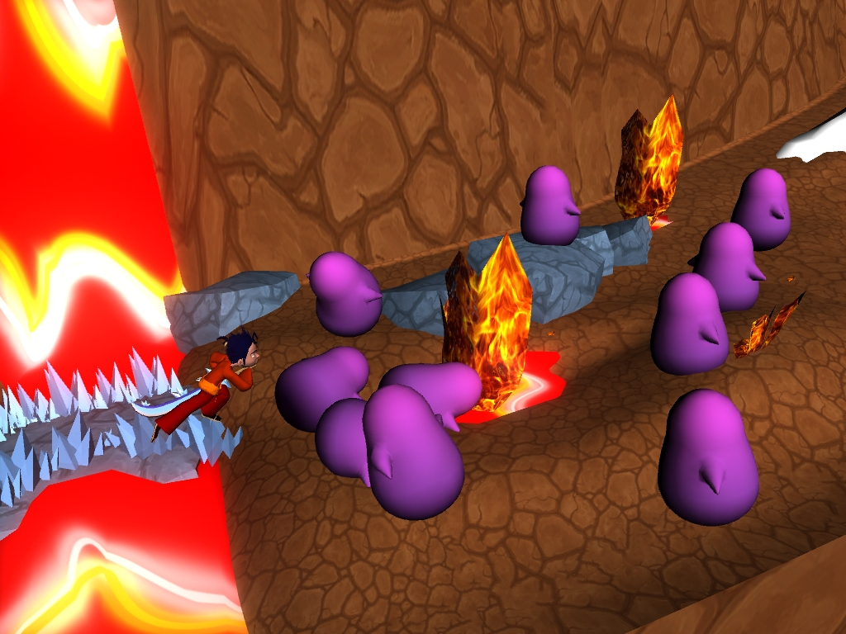
Encounter + Lava Trap
W
Lava Traps – Player must dash
10 Melee Minions
A
S
D
Movement
K
Ice
Notes:
4 Lava Traps
10 Melee Minions

Slide 37

Environment Challenge
W
8 Ice Traps along a narrow path way
3 unreachable Ranged Minions
Player can advance without killing enemies
A
S
D
Movement
J
Fire
Notes:
8 ice traps along a narrow path way.
3 Ranged Minions off on a separate platform.
Player can advance without killing enemies.

Slide 38

Turning Up the Difficulty
W
3 Melee Minions
2 Explosive Minions
3 Ranged Minions
2 Fire Beasts
A
S
D
Movement
K
Ice
Notes:
A mixed wave of enemies
3 Melee Minions
2 Explosive Minions
3 Ranged Minions
2 Fire Beasts

Slide 39

More Encounters
W
5 Melee Minions
2 Explosive Minions
2 Ice Beasts
A
S
D
Movement
J
K
Fire
Ice
Notes:
A mixed wave of enemies
5 Melee Minions
2 Explosive Minions
2 Ice Beasts

Slide 40

Encounter
W
3 Melee Minions
2 Explosive Minions
4 Ranged Minions
2 Fire Beasts
1 Ice Beast
A
S
D
Movement
J
K
Fire
Ice
Notes:
A mixed wave of enemies
3 Melee Minions
2 Explosive Minions
4 Ranged Minions
2 Fire Beasts
1 Ice Beast

Slide 41
Encounter
W
3 Melee Minions
3 Explosive Minions
3 Ranged Minions
1 Fire Beast
2 Ice Beasts
A
S
D
Movement
J
K
Fire
Ice
Notes:
A mixed wave of enemies
3 Melee Minions
3 Explosive Minions
3 Ranged Minions
1 Fire Beast
2 Ice Beasts

Slide 42

Final Encounter
W
4 Melee Minions
4 Explosive Minions
4 Ranged Minions
2 Fire Beasts
2 Ice Beasts
A
S
D
Movement
J
K
Fire
Ice
Notes:
A mixed wave minions
4 Melee Minions
4 Explosive Minions
4 Ranged Minions
2 Fire Beasts
2 Ice Beasts

Slide 43

For Boss Time!
W
The Wizard enters with his opening dialogue
Sound of traps activating
Wizard calls forth Fire and Ice to make the Player dodge
A
S
D
Movement
Spacebar
Dash
Notes:
The Wizard Enters with his opening dialogue
The sound of traps activating.
Wizard calls forth fire and ice to make the player dodge around.
After some casting he grows tired and must recover, player can now attack him
After he has recovered causes an area of effect, player can be stunned if too close.

Slide 44

W
After some casting the Wizard grows tired and must recover
Player should use this time to attack him
A
S
D
Movement
J
K
Fire
Ice
After recovering the Wizard causes AOE damage and stun

Slide 45

This isn’t even my Final Form!
W
A
S
D
Movement
J
K
Fire
Ice
The Wizard opens with his second bit of dialogue
Sound of shield rising
Deflect his own attacks (3x) – same element
Notes:
Wizard opens with his second bit of dialogue.
The sound of a shield rising
His shield must be disabled with his own attacks (3 times).
Player must use the same attack when deflecting.
Using the same attack enhances the attack, using the opposite will destroy it.
After he has recovered causes an area of effect, player can be stunned if too close.

Slide 46

It’s not over yet!
W
A
S
D
Movement
J
K
Fire
Ice
The Wizard transforms into a giant
Slams fists into the ground (Fire or Ice)
Player must use the opposite element before he lifts his hand up
Notes:
The sound of something getting bigger
The wizard transforms into a giant.
He slams his fists into the ground.
Takes a few seconds to lift his hands up
Left fist is fire.
Right fist is ice.
Player must use the opposite element

Slide 47

Ending
Wizard gives his Final Worlds
Main character is reunited with his love and they embrace each other
Roll Credits
Music stops

Slide 48

Questions and Answers

